Slide 1
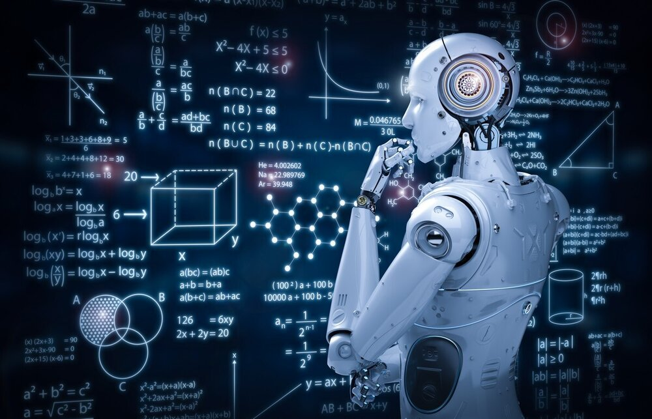
IUST_NLPLAB
At ImageCLEF
medical Caption Tasks
2022

Slide 2
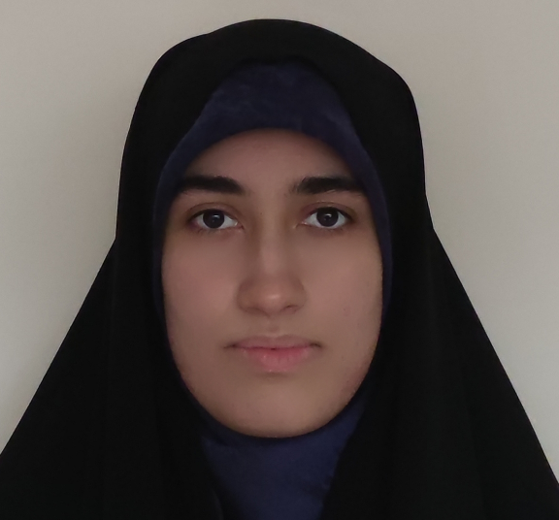
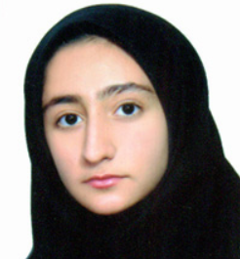
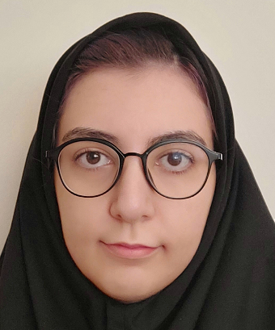
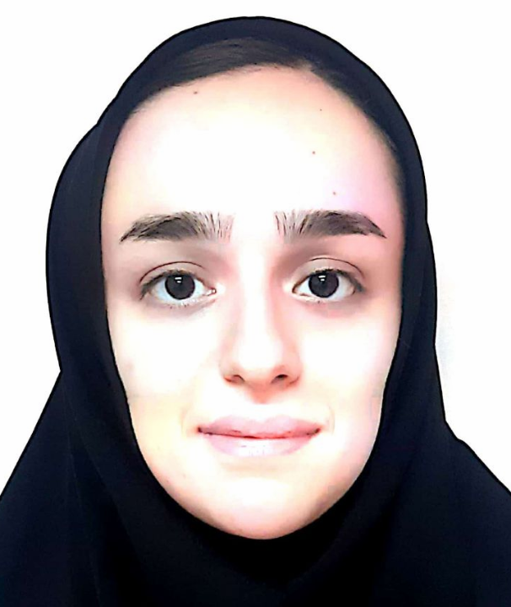
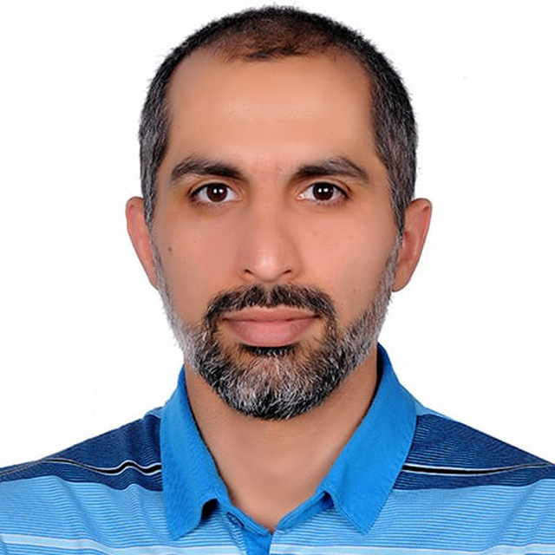
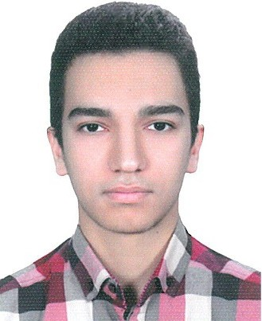
OUR TEAM
Malihe Hajihosseini
m_hajihosseini@comp.iust.ac.ir
Fateme Omidi
f_omidi97@comp.iust.ac.ir
Yasaman Lotfollahi
y_lotfollahi@comp.iust.ac.ir
Melika Nobakhtian
m_nobakhtian@comp.iust.ac.ir
Sauleh Eetemadi
sauleh@iust.ac.ir
MohammadMahdi Javid
mahdijavid1380@yahoo.com

Slide 3

Get your hands dirty with code

Slide 4





ACKNOWLEDGEMENT
This work has been supported by the Simorgh Supercomputer - Amirkabir University of Technology under Contract No ISI-DCE-DOD-Cloud-900808-1700.

Slide 5
brief introduction to Dataset

Slide 6
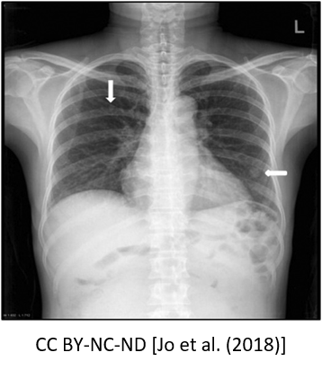
CONCEPT DETECTION
concepts
C1306645 (Plain x-ray) C0817096 (Chest) C0225759 (Lung field)

Slide 7
concepts
UMLS CUI | UMLS Meaning | Frequency
C0040405 | X-Ray Computed Tomography | 25989
C1306645 | Plain x-ray | 24389
C0024485 | Magnetic Resonance Imaging | 14622
C0041618 | Ultrasonography | 11147
C0817096 | Chest | 7720
C0002978 | angiogram | 6027
C0000726 | Abdomen | 5772
C0037303 | Bone structure of cranium | 5144
C0221198 | Lesion | 3845
C0205131 | Axial | 3187

Slide 8
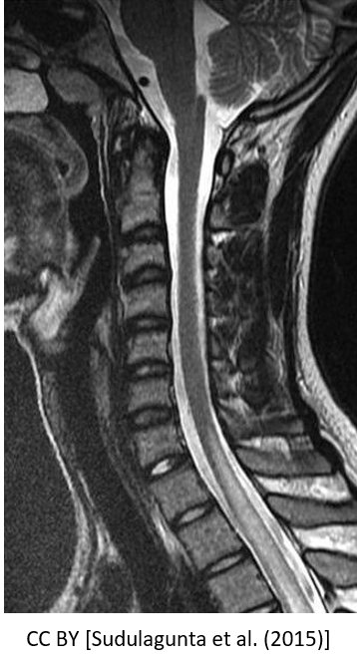
Caption prediction
caption
mri spine show hyperintensity in the thoracic cord till level

Slide 9

dataset
Train
validation
test
concepts
Containing 83275 images with their concepts and captions.
Containing 7645 images with their concepts and captions.
Containing 7601 images with their concepts and captions.
Containing 8374 concepts of medical.

Slide 10
Concepts detection
Contain 8374 concepts in dataset
3718 images have only one concept.
The maximum number of concepts for an image was 50.
On average, five concepts are specified for each image.

Slide 11
Caption prediction
Numbers and words containing numbers were removed.
All punctuation was removed.
Lemmatization was applied using SpaCy.
Captions were converted to lower-case.
194 images have one-word captions.
The maximum caption length is 391.
The most common caption length is ten words.

Slide 12
Methods

Slide 13
Image Pre-Processing Techniques

Slide 14
Histogram equalization
uses a contrast enhancement technique.
flattening the image histogram as much as possible and mapping the probability distribution to a uniform probability distribution.
may have a bad output because the average brightness of the output is significantly different from the input image.

Slide 15
clahe
a type of Histogram Equalization.
contrast amplification is limited in this method.
In a typical Histogram Equalization, we see an increase in noise in near-constant regions.
CLAHE equalizes the brightness and contrast of the images.
divide the image into sections
apply histogram equalization to each section
Apply the contrast amplification limit, known as clip limit
We used a clip limit of 2 in our models

Slide 16
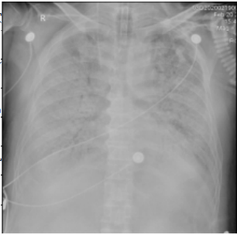
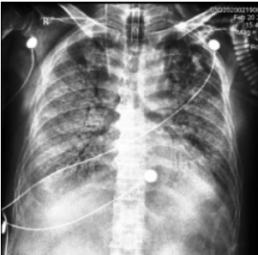
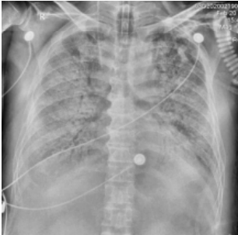
applying clahe and histogram equalization On a normal image
Normal | Histogram Equalization | CLAHE

Slide 17
Caption Prediction

Slide 18
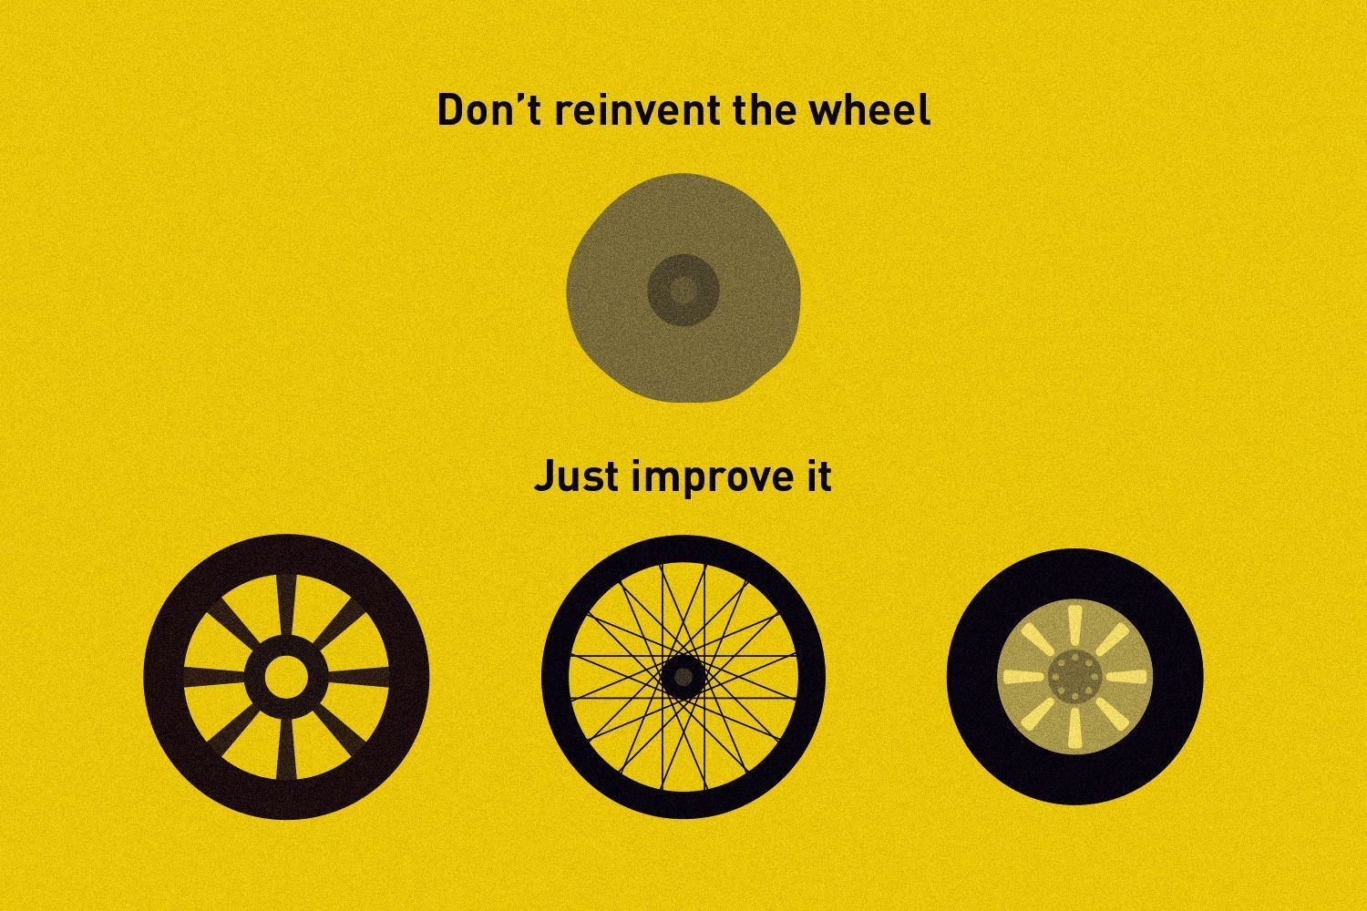

Slide 19

Approach
Last Year Winner Team’s Approach
PUC Chile team
Each word is considered to be a label.
A multi-label classification model is used to predict the corresponding words.
Words are ordered to create a caption.

Slide 20
Implementation
Building a classification model and fine-tuning
A CNN pre-trained on ImageNet
The last layer of the CNN was removed.
A dropout layer, an activation layer, and an output layer were added.
Fine-tuned it on the subtask training set.
Output layer: A dense layer with the size of vocab words, and with sigmoid activation function

Slide 21
Implementation
Generating captions
Choosing the words
1
Probability of each word is predicted with the model. the top 𝑁 words with the highest probability are chosen.
2
Ordering the words
Highest to lowest probability
Based on their most common position in training set captions

Slide 22
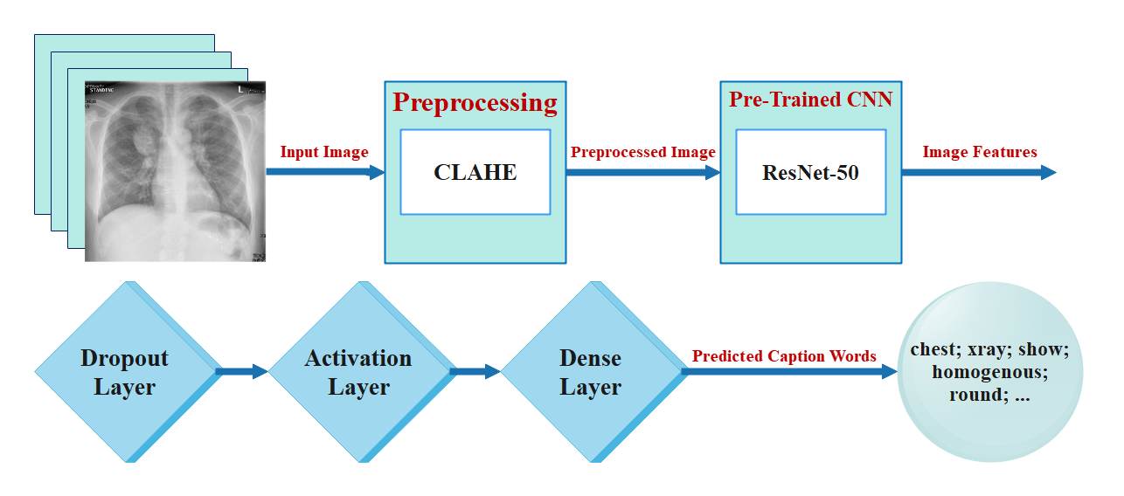
Model architecture

Slide 23
Experiments
Different CNNs
Different configurations
Different Ns
ResNet50, DenseNet121, etc
Different activation functions, which layers to freeze during fine-tuning, etc
From 15 to 27

Slide 24
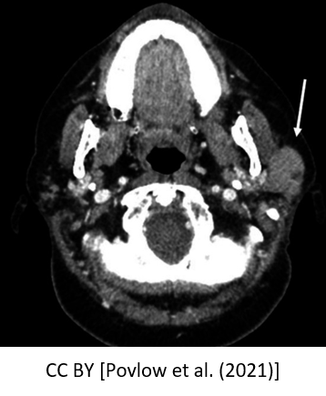
Examples
Ground Truth | Predicted caption
axial ct image of the neck with intravenous contrast at the level of the parotid gland show asymmetric left parotid gland enlargement with replacement by a soft tissue mass white arrow | arrow show ct axial imag tomographi enhanc scan comput left right mass muscl lesion enlarg gland red neck view contrast tissu soft demonstr white nerv tumor
BLEU: 0.806
ROUGE: 0.468

Slide 25
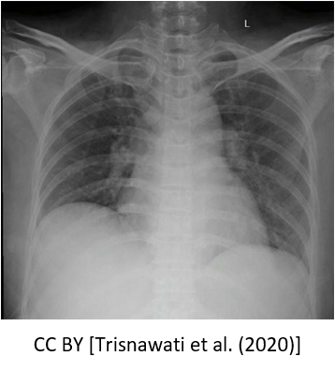
Examples
Ground Truth | Predicted caption
chest xray show bilateral pneumonia | chest xray show left patient leav right arrow lung pleural effus hemithorax admiss radiograph lobe mediastin mass tip day mediastinum postop elev upper enlarg tube imag
BLEU: 0.140
ROUGE: 0.193

Slide 26

Results
All our ten submissions had BLEU scores higher than 0.430 and ranked from 1 to 10 on the released leaderboard.
Best result was achieved by
Using ResNet50,
Setting 𝑁 to 26,
Using ReLU as the activation function,
Ordering words from highest to lowest probability.

Slide 27
Things to improve
Generating captions with different lengths
Ordering words better to make a sentence
Grammar

Slide 28
MLOPS

Slide 29
Memory optimization
Large data → do not fit into memory
Data generator → generate lazy (on demand)
Not feasible to load all the data into the Memory
Request → Generators with multiprocessing
Pitfalls:
Mutable global variable
Anti-patterns

Slide 30
Faster EXECUTION?
TensorBoard Profiling Tool
Concept Detection → used only once → 15 days
hardware resource consumption based on information gathered during the program’s execution to identify which part of our program needs optimization and how we can speed up the overall program while minimizing resources.

Slide 31
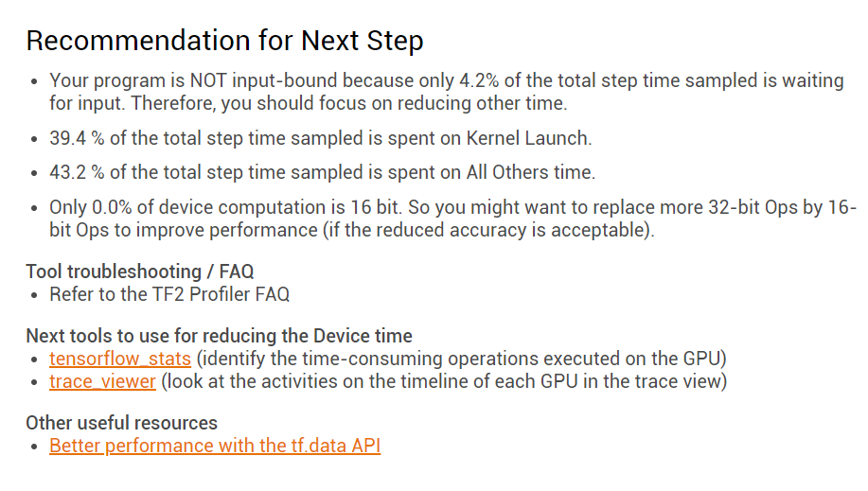

Slide 32
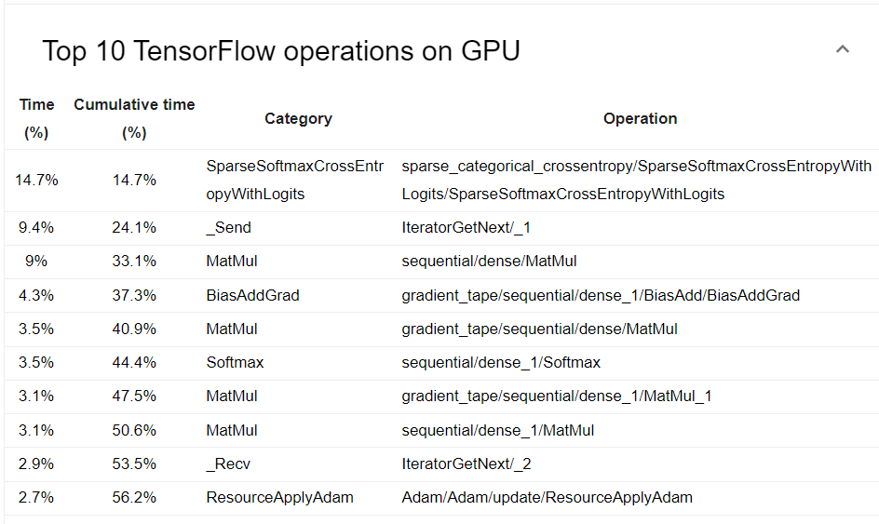

Slide 33
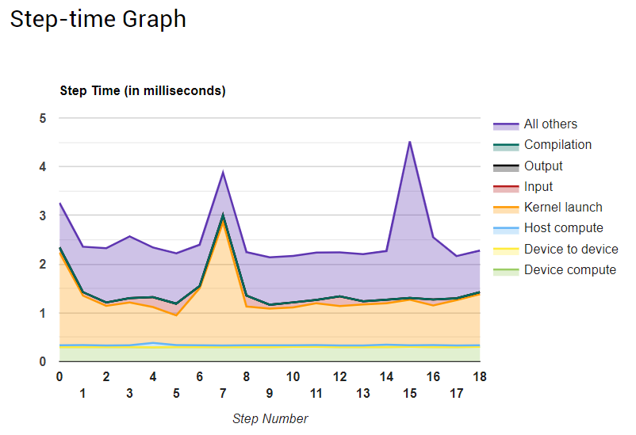

Slide 34
CPU?
Multiprocessing
Multithreading
Difference???
The more processes or threads we have, the faster it is.

Slide 35
I/O bound?
Caching?
Pre-fetching

Slide 36
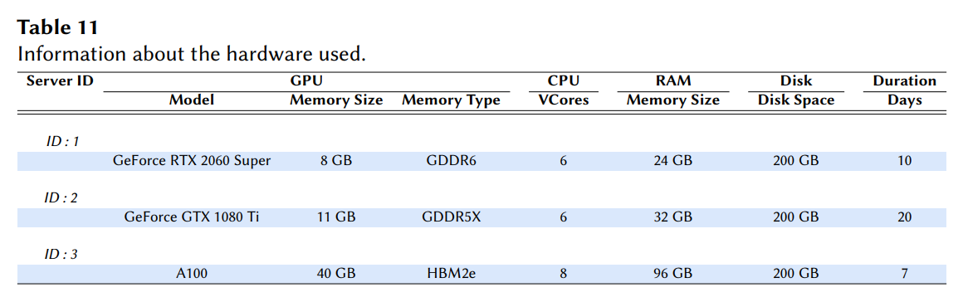
USAGE

Slide 37
LEADERBOARD

Slide 38
Rank | Group Name | BLEU | ROUGE | METEOR | CIDEr | SPICE | BERTScore
1 | IUST_NLPLAB | 0.482796 | 0.142206 | 0.092754 | 0.030356 | 0.007231 | 0.561192
2 | AUEB-NLP-Group | 0.322165 | 0.166498 | 0.073744 | 0.190217 | 0.031258 | 0.598860
3 | CSIRO | 0.311356 | 0.197439 | 0.084137 | 0.269338 | 0.046228 | 0.623419
4 | vcmi | 0.305778 | 0.173754 | 0.074579 | 0.204668 | 0.035778 | 0.604429
5 | eecs-kth | 0.291664 | 0.115669 | 0.062403 | 0.131695 | 0.021826 | 0.572823
6 | fdallaserra | 0.291316 | 0.201163 | 0.081942 | 0.256383 | 0.046359 | 0.610078
7 | kdelab | 0.278265 | 0.158389 | 0.073531 | 0.411406 | 0.051164 | 0.600314
8 | Morgan_CS | 0.254931 | 0.144074 | 0.055924 | 0.148146 | 0.023232 | 0.583494
9 | MAI_ImageSem | 0.221136 | 0.184723 | 0.067541 | 0.251316 | 0.039311 | 0.605873
10 | SSNSheerinKavitha | 0.159522 | 0.042500 | 0.022645 | 0.016949 | 0.007213 | 0.545069

Slide 39
Concept Detection
Multi-Label Classification
Method
Information
Retrieval
Approach
Information
Retrieval
Approach
Multi-label Classification
Information retrieval

Slide 40
Information Retrieval
Approach

Slide 41
Approach
Last Year Winner Team’s Approach
AUEB NLP
This team used 3 different methods in the concept detection subtask: 2xCNN + FFNN, 1-NN Ensemble and combination of these two methods.
Their best system was based on 1-NN ensemble

Slide 42
1-NN ensemble
Training
Three kind of different encoders are employed:
ResNet-50, DenseNet-201 and EfficientNet-B0
Pre-trained on ImageNet
Fine-tuned on training set for five epochs
Best weights are saved for each of encoders according to loss values on training set

Slide 43
1-NN ensemble
validation
We will create 5 samples from each encoder in the last step.
At last, we will have 15 encoders.
These encoders will be fine-tuned on a part of validation set for 3 epochs.

Slide 44
1-NN ensemble
Image retrieval
We will repeat these steps for each of 15 encoders:
using encoder to get image embeddings of training set.
embeddings are retrieved from the last average pooling layer of encoder.
also using encoder to get image embeddings of test set.
computing similarity between each test image and all of training images.
finding the most similar training image to a test image.
At the end we will have 15 training images for a test image.

Slide 45
1-NN ensemble
Majority voting mechanism
We used Majority Voting Mechanism to assign concepts to images
Select N as a threshold for this method
Find concepts that appear more than N times in 15 training images for a test image
Assign these concepts to the test image
N=8 is the best value for this threshold according to accuracy and F1-score

Slide 46
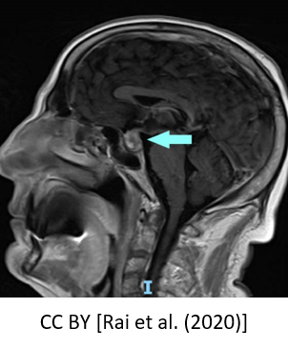
Examples
Ground Truth | Prediction
C0024485(Magnetic Resonance Imaging) C0346308 (Pituitary macroadenoma) C0205129 (Sagittal) | C0024485(Magnetic Resonance Imaging) C0346308 (Pituitary macroadenoma) C0205129 (Sagittal)
F1 SCORE: 1

Slide 47
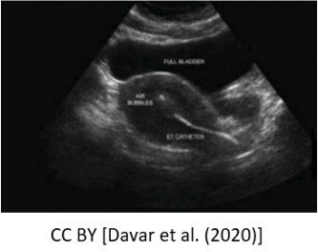
Examples
Ground Truth | Prediction
C0024485(Magnetic Resonance Imaging) C0016823 (Structure of fundus of eye) | C0024485(Magnetic Resonance Imaging) C0016823 (Structure of fundus of eye) C0439828 (Variable (uniformity)) C0205396 (Identified) C0013938 (Embryo transfer (procedure))
F1 SCORE: 0.571

Slide 48
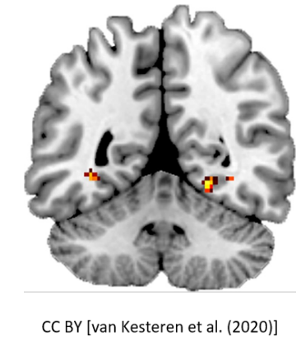
Examples
Ground Truth | Prediction
C1707489 (Connectivity) C0205202 (Corrected) | C0221198 (Lesion) C0024485 (Magnetic Resonance Imaging)
F1 SCORE: 0.0

Slide 49
Multi-label classification

Slide 50
Implementation
approach
Considered image concepts as labels
Built a multi-label classification model

Slide 51
Implementation
Building a classification model and fine-tuning
A CNN pre-trained on ImageNet
The last layer of the CNN was removed.
An output layer with 8374 units, and with sigmoid activation function were added.
Fine-tuned it on the subtask training set.

Slide 52
Experiments
Different CNNS
Different Thresholds
Different Regularizations
Different preprocessing and data augmentation methods
ResNet50, InceptionV3, etc
L2, Dropout
CLAHE, Horizontal Flip, etc

Slide 53
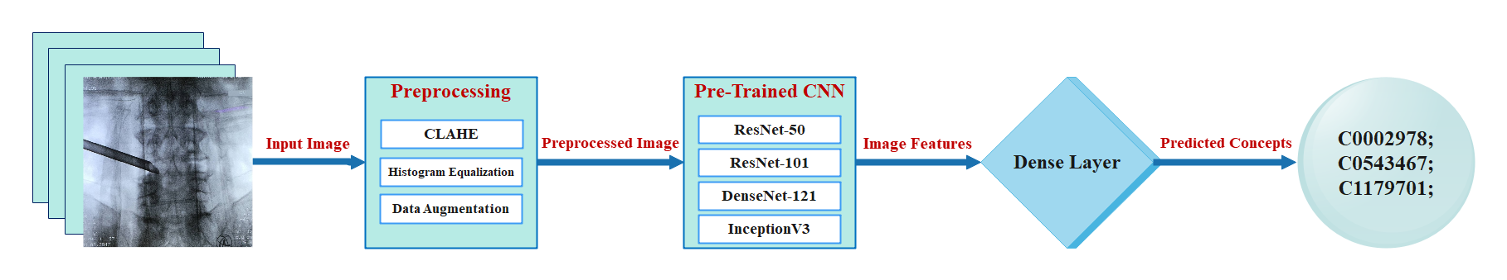
Model architecture

Slide 54
LEADERBOARD

Slide 55
Rank | Group Name | F1 Score | Secondary F1
1 | AUEB-NLP-Group | 0.451123 | 0.790724
2 | fdallaserra | 0.450532 | 0.822240
3 | CSIRO | 0.447134 | 0.793645
4 | eecs-kth | 0.436013 | 0.854593
5 | vcmi | 0.432871 | 0.863373
6 | PoliMi-ImageClef | 0.431955 | 0.851217
7 | SSNSheerinKavitha | 0.418433 | 0.654361
8 | IUST_NLPLAB | 0.398086 | 0.673188
9 | Morgan_CS | 0.351988 | 0.628052
10 | kdelab | 0.310428 | 0.411958
11 | SDVA-UCSD | 0.307932 | 0.552432

Slide 56
The end

